Slide 1
Mann–Whitney U Test
Gilbert Böhme / Tobias Dudek 29.08.2025
CAS ADS Module 2 - University of Berne

Slide 2
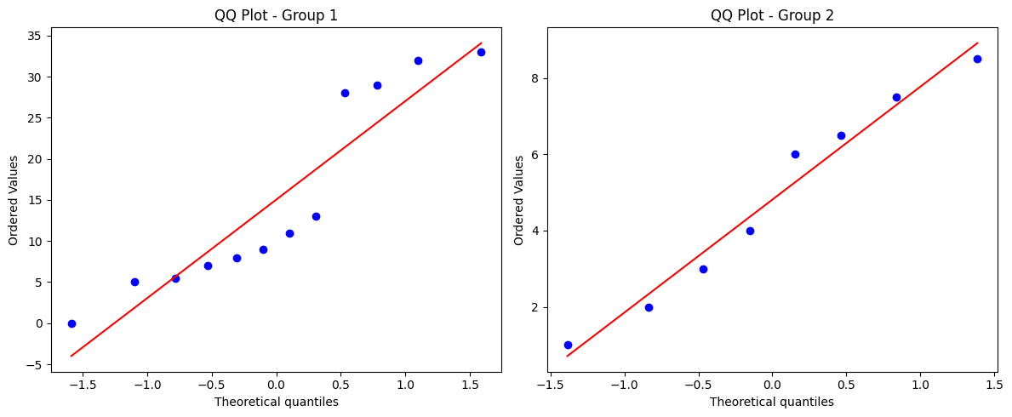
Case: well-being of cardiac patients
Study design:
Sample¹: 20 hospital patients
Groups:
12 cardiac patients (group 1)
8 non-cardiac patients (group 2)
Measure: questionnaire on general well-being (0 = very high, 35 = very low)
Goal: test whether central tendency of well-being differs between groups
Analysis outcome:
reject H0 that the expected well-being of group 1 is similar to that of group 2 at the 5% significance level (p-value = 0.025)
1 Data taken from: https://www.methodenberatung.uzh.ch/de/datenanalyse_spss/unterschiede/zentral/

